Slide 1


Assessing the Effect of Protein Structure on Amino Acid Evolution
Peter Goodman¹
Mentored by Dr. Joanna Masel²
University of Arizona
AZSGC Symposium - April 18, 2026
Statistics & Data Science¹ Department of Ecology & Evolutionary Biology²

Slide 2
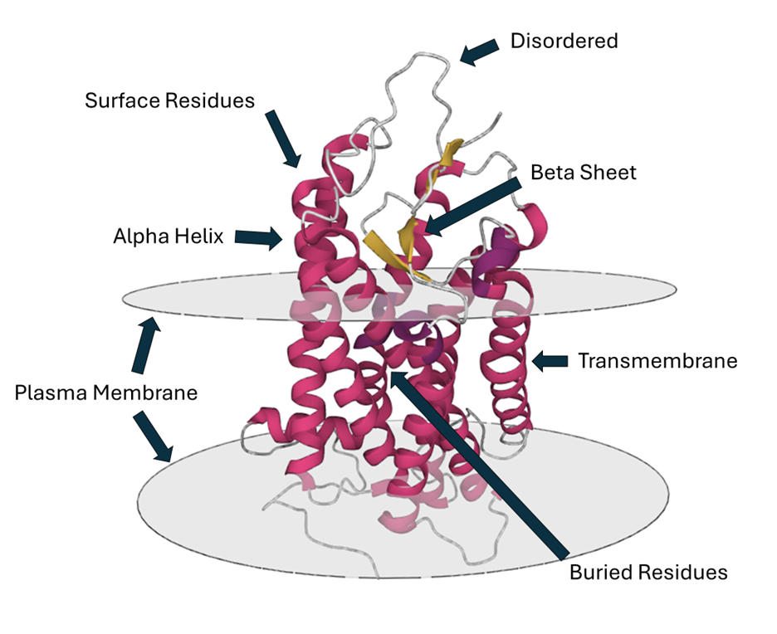
Proteins
Chains of Amino Acids
Folded into shapes (structure)
DNA codes for proteins

Slide 3
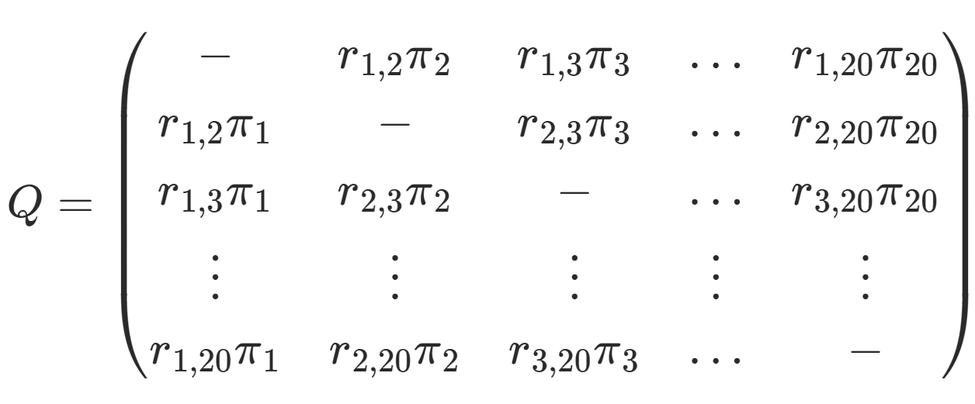
Substitution Models
How often does one element of genetic code “substitute” for another?
20 Amino Acids in the Genetic Code →
Q (Rate Matrix)
  20x20
  How often does an Arginine evolve into a Lysine, etc.
Used to infer phylogenetic trees
  Better model, more accurate tree?

Slide 4
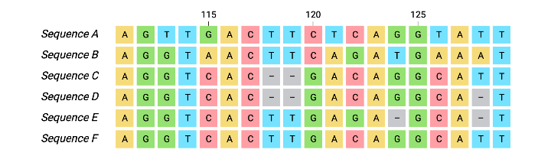
How to infer a Substitution Model?
MSA = Multiple Sequence Alignment
  Align the same gene across multiple species
Initial methods involved counting the times a substitution was present
Currently, we use maximum likelihood estimation

Slide 5
How to apply Protein Structure to Substitution Models?

Slide 6
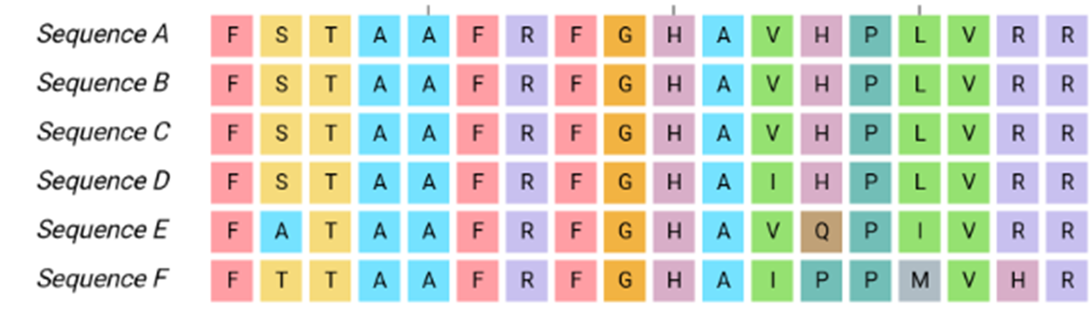
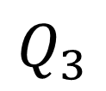
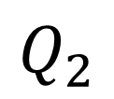
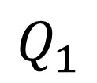
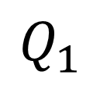
Partition Model
Common practice to apply one Q matrix to one MSA
Partition Model = Applying multiple Q matrices to one MSA
Standard Method
Partition Model
$$Q_{1}$$
$$Q_{1}$$
$$Q_{2}$$
$$Q_{3}$$

Slide 7
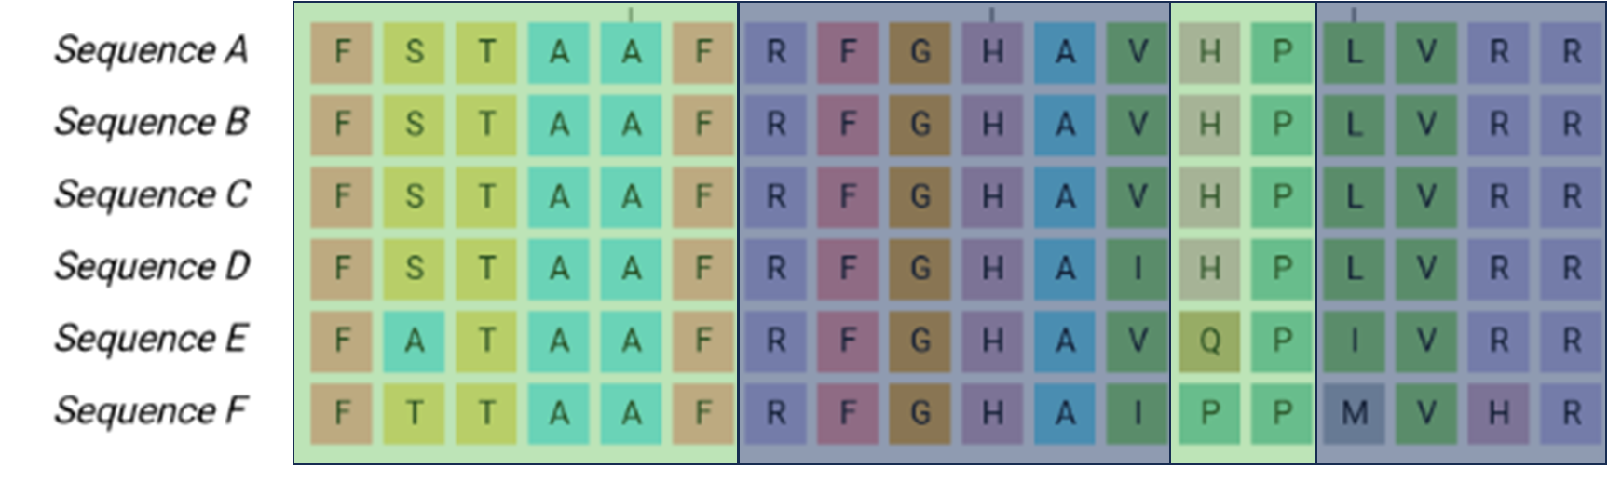
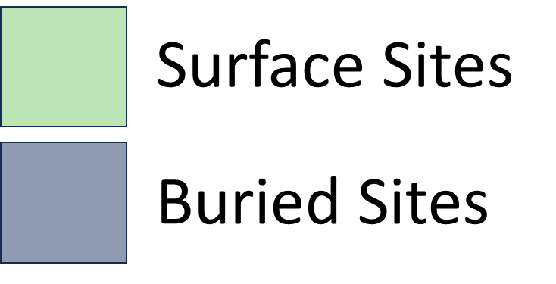
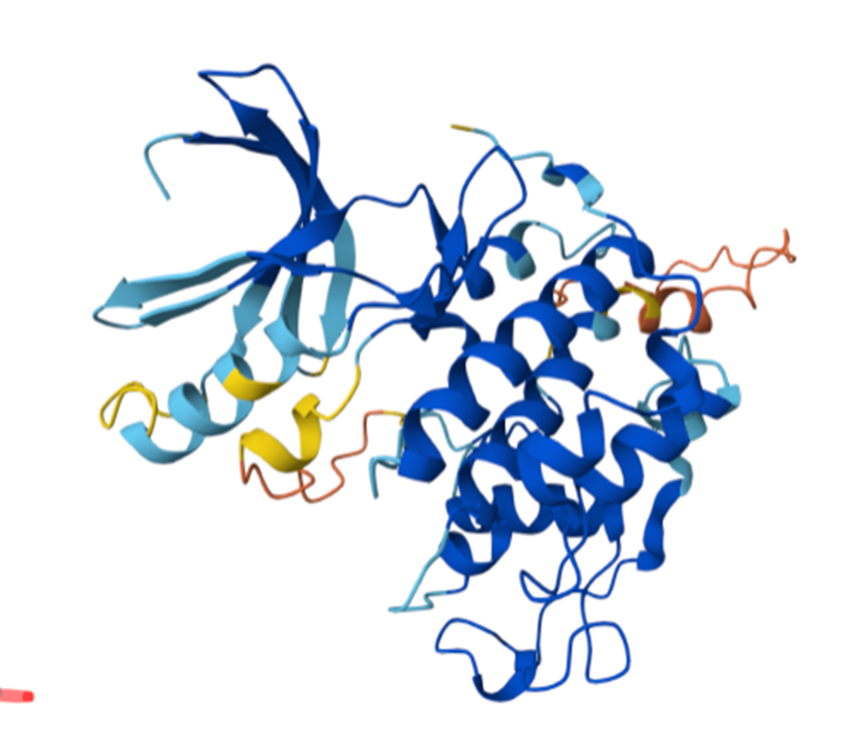

How to build a (structural) Partition Model?
Partition the alignment based on structural annotations
  Exposed/Surface, Buried, Uncertain
How to get structural annotations?
  AlphaFold Database!

Slide 8
Do Amino Acid Exchangeabilities Capture Structural Differences?

Slide 9
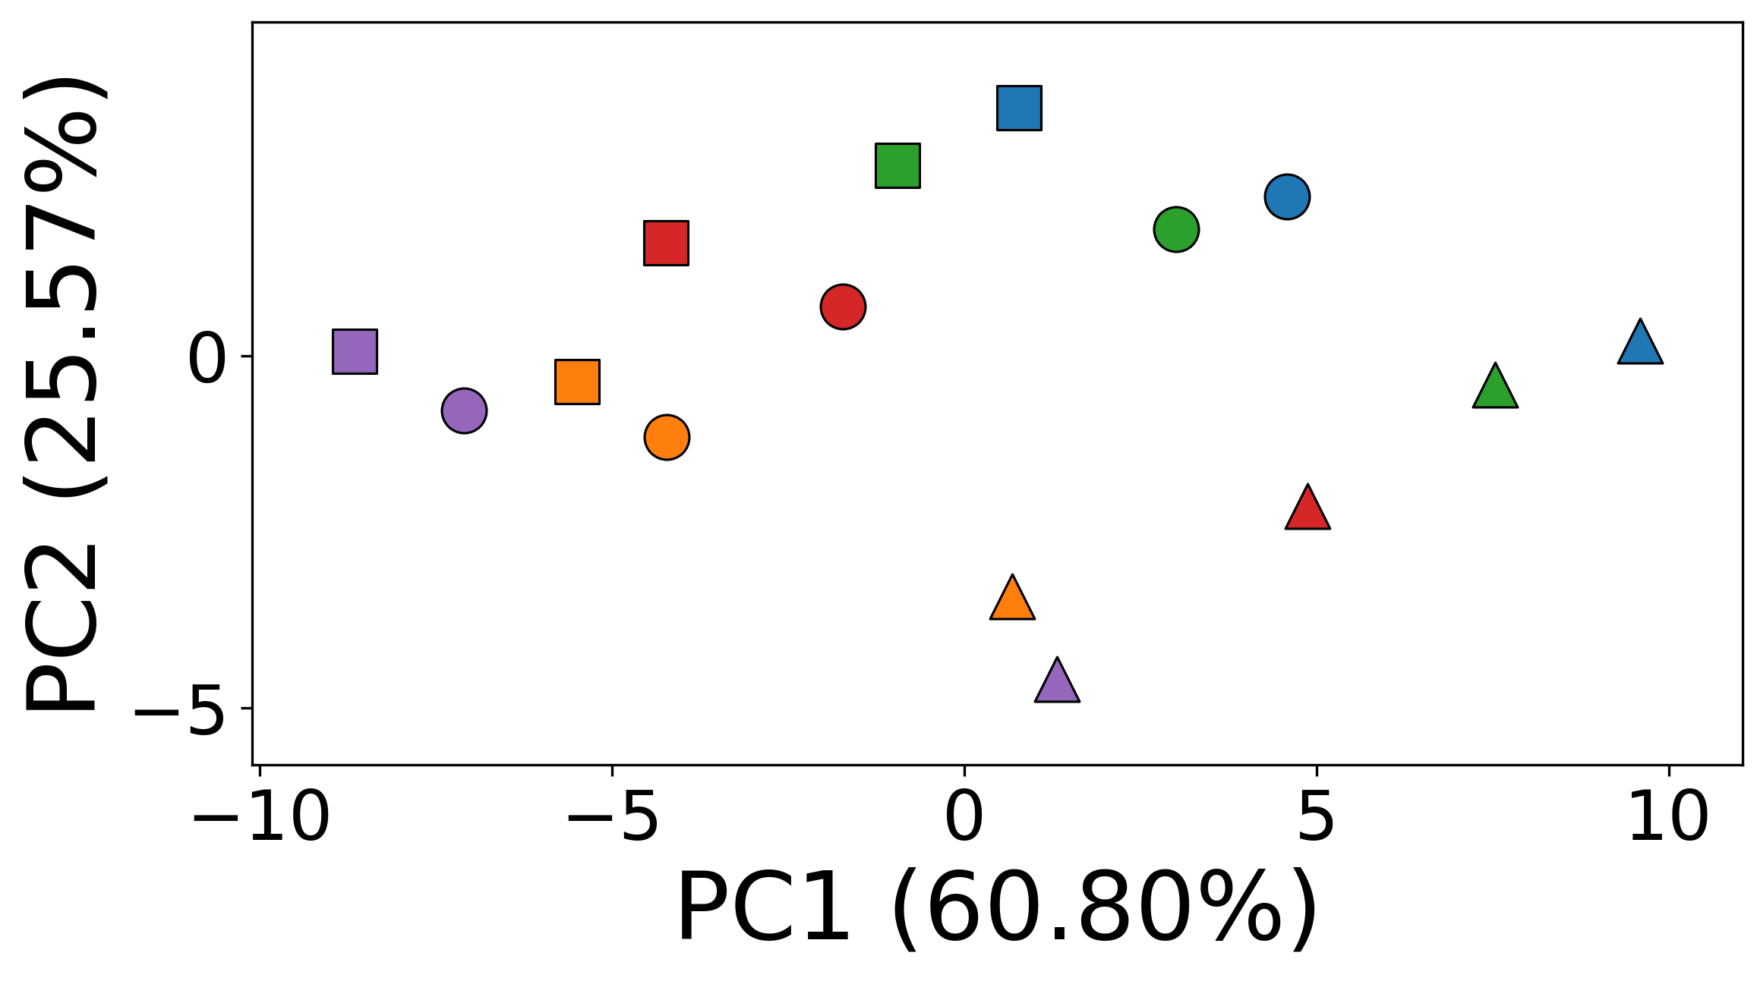
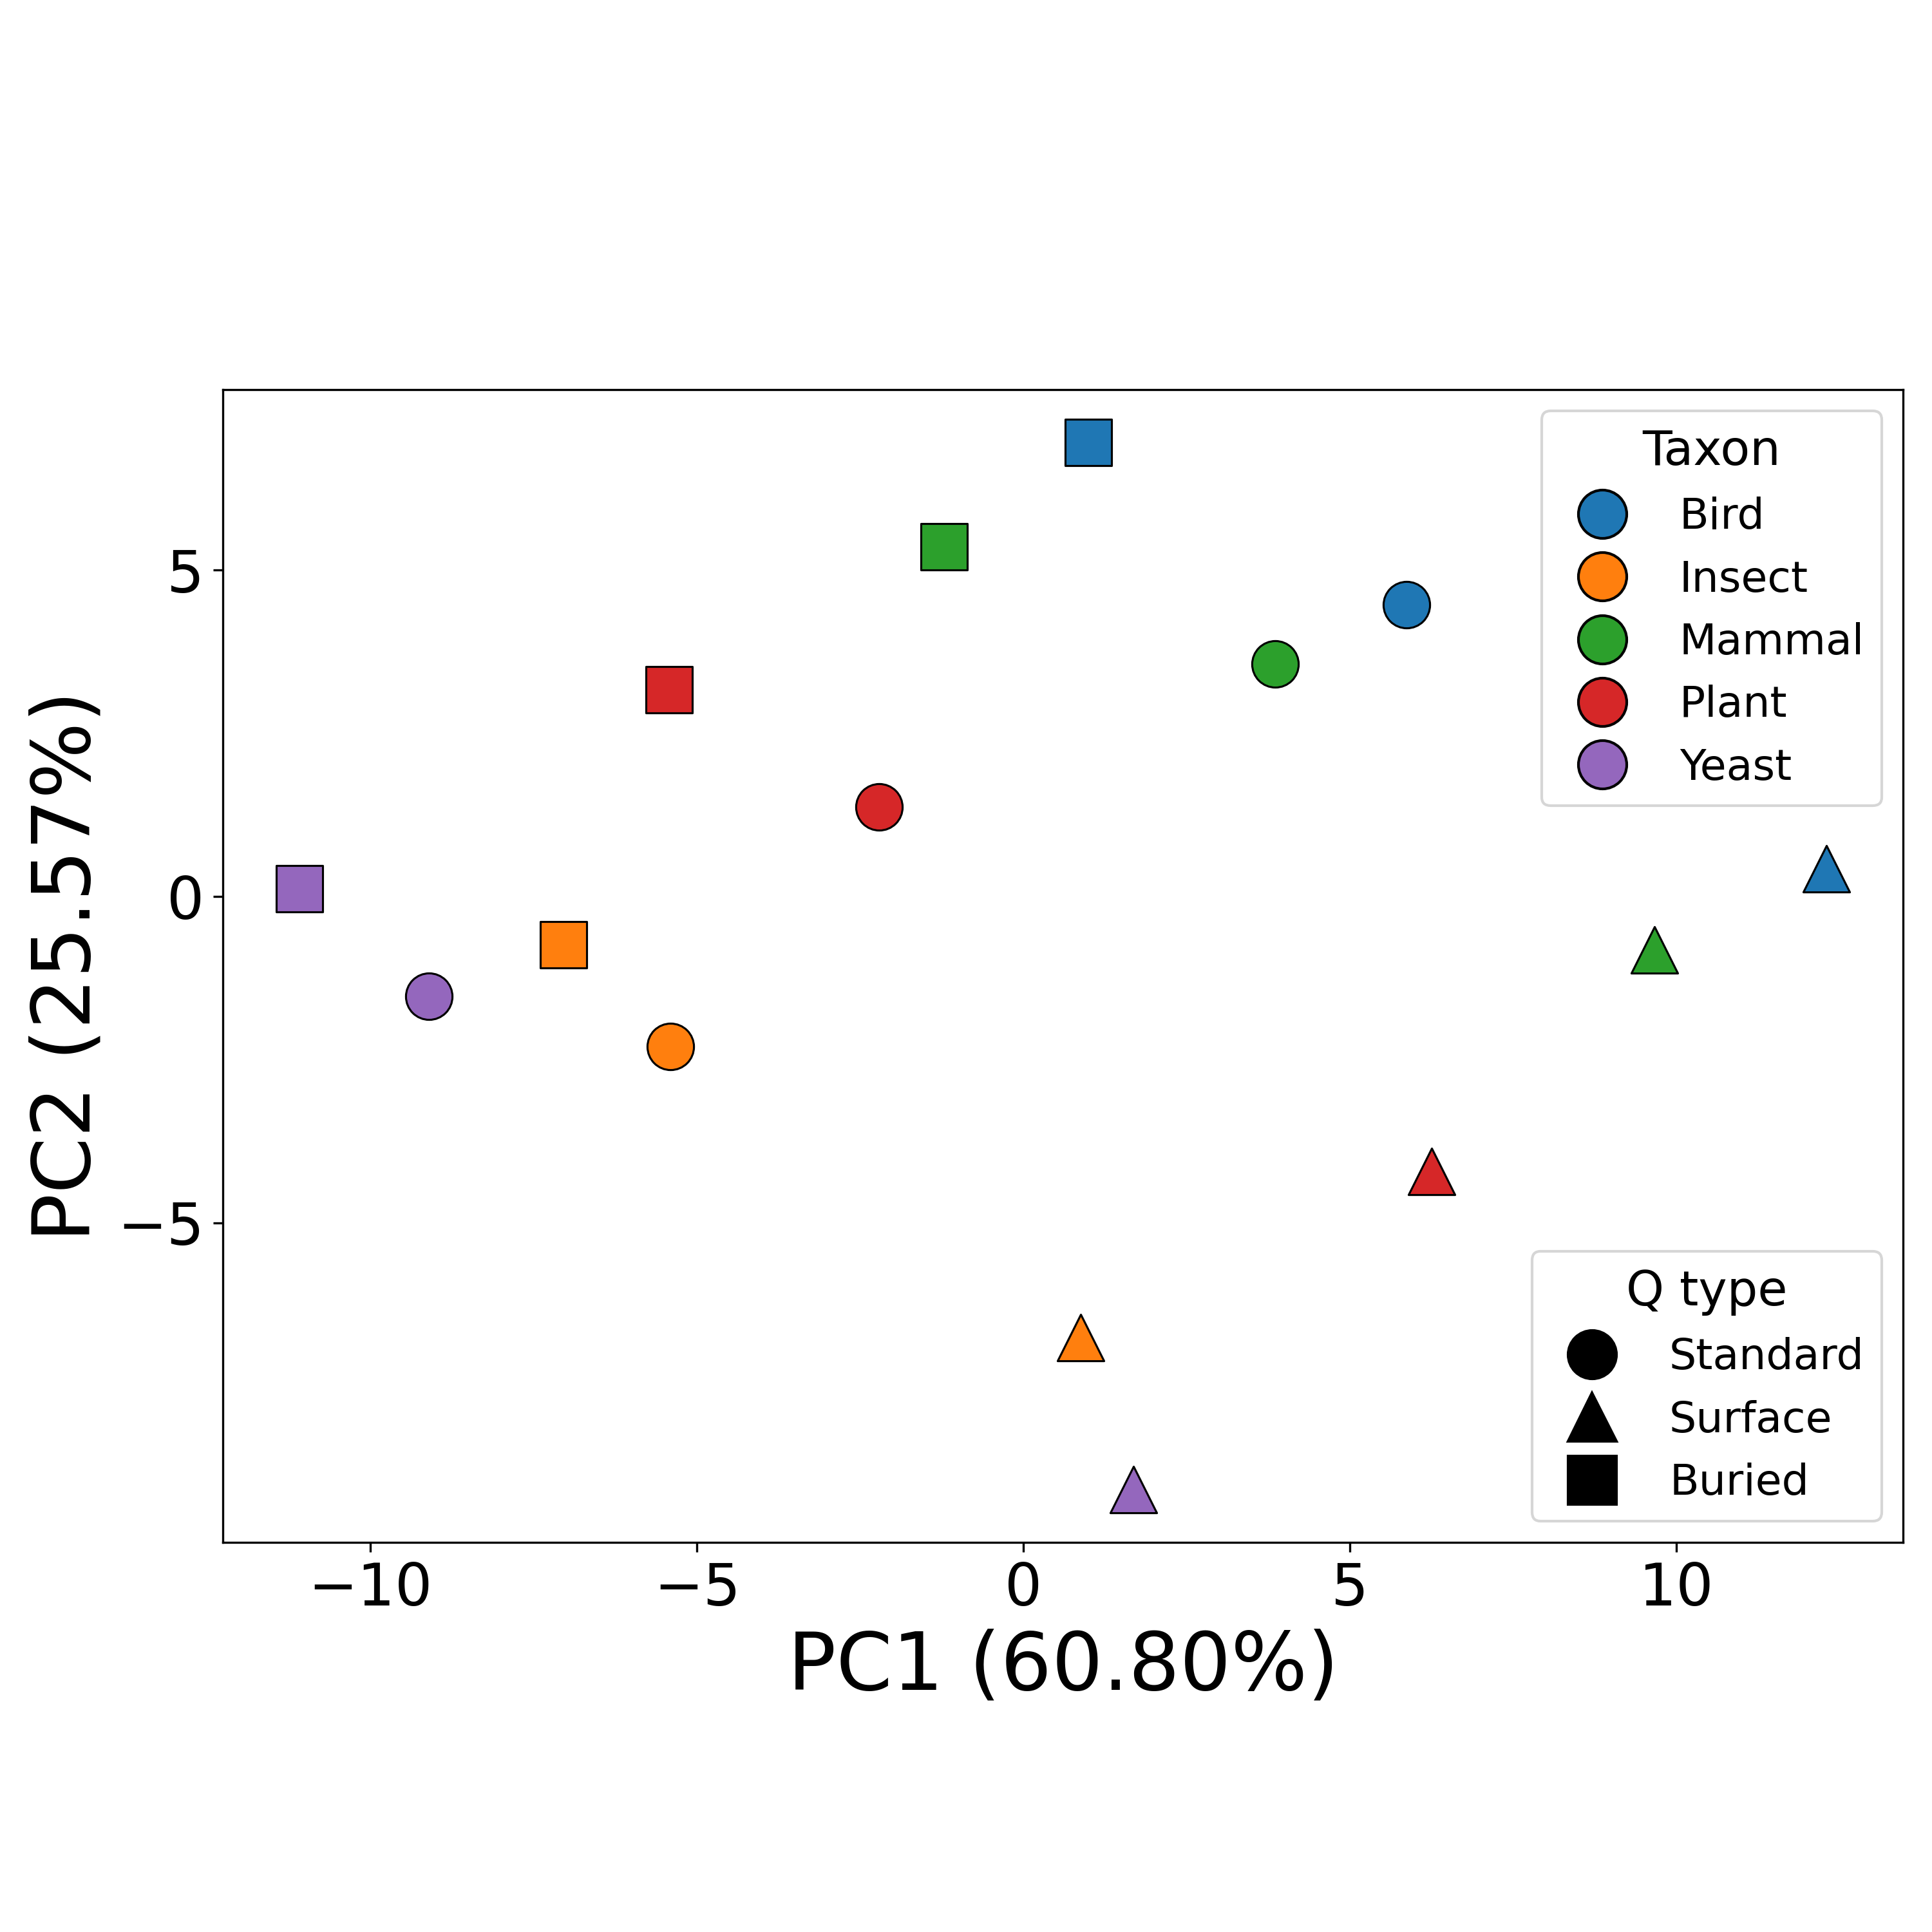
Yes - Even more than species

Slide 10
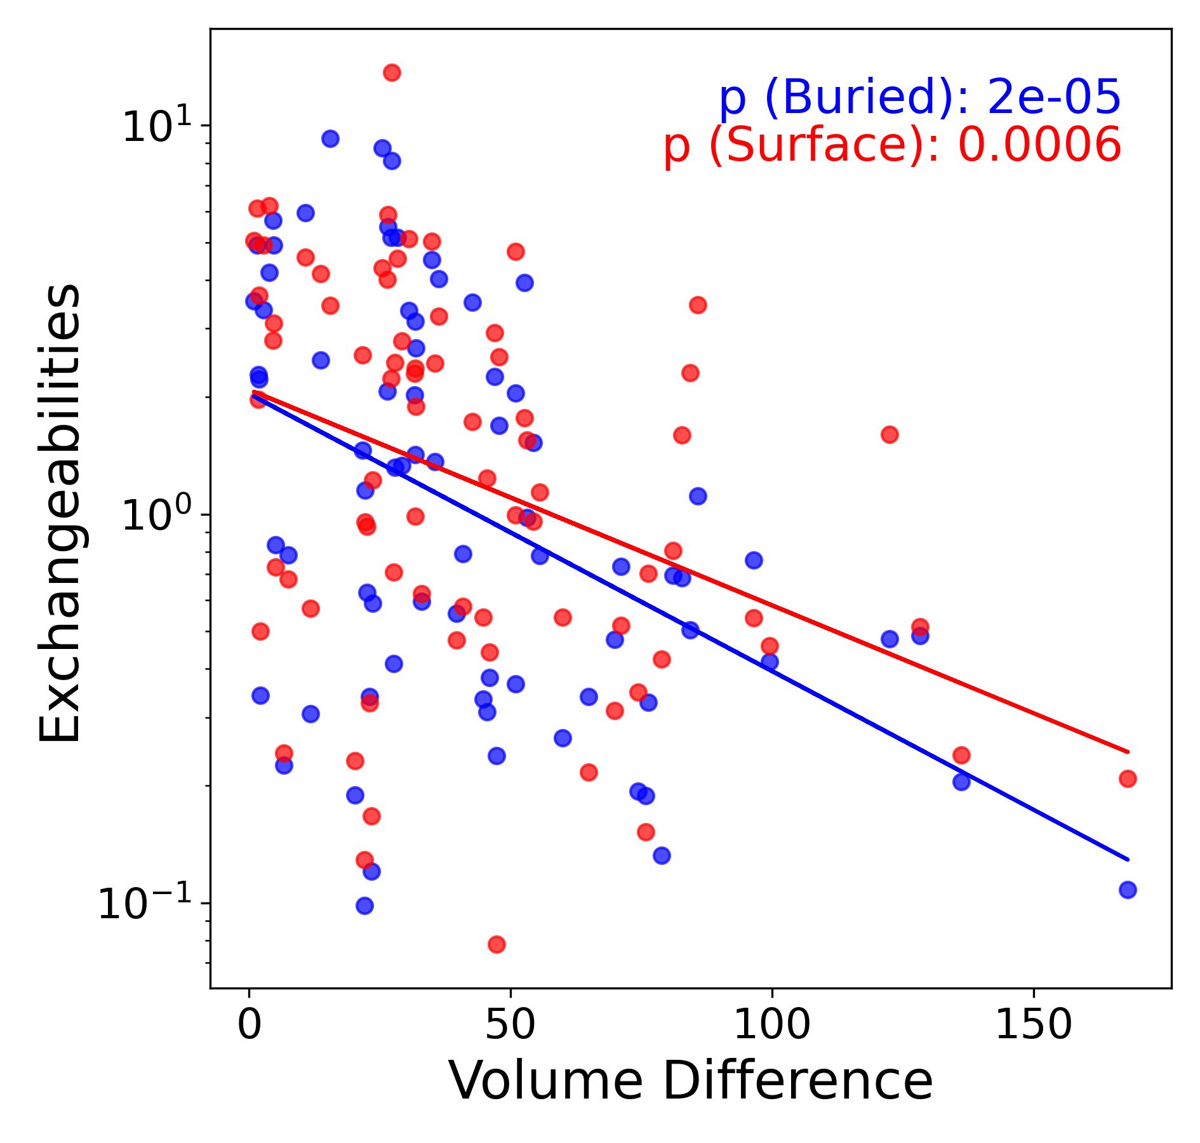
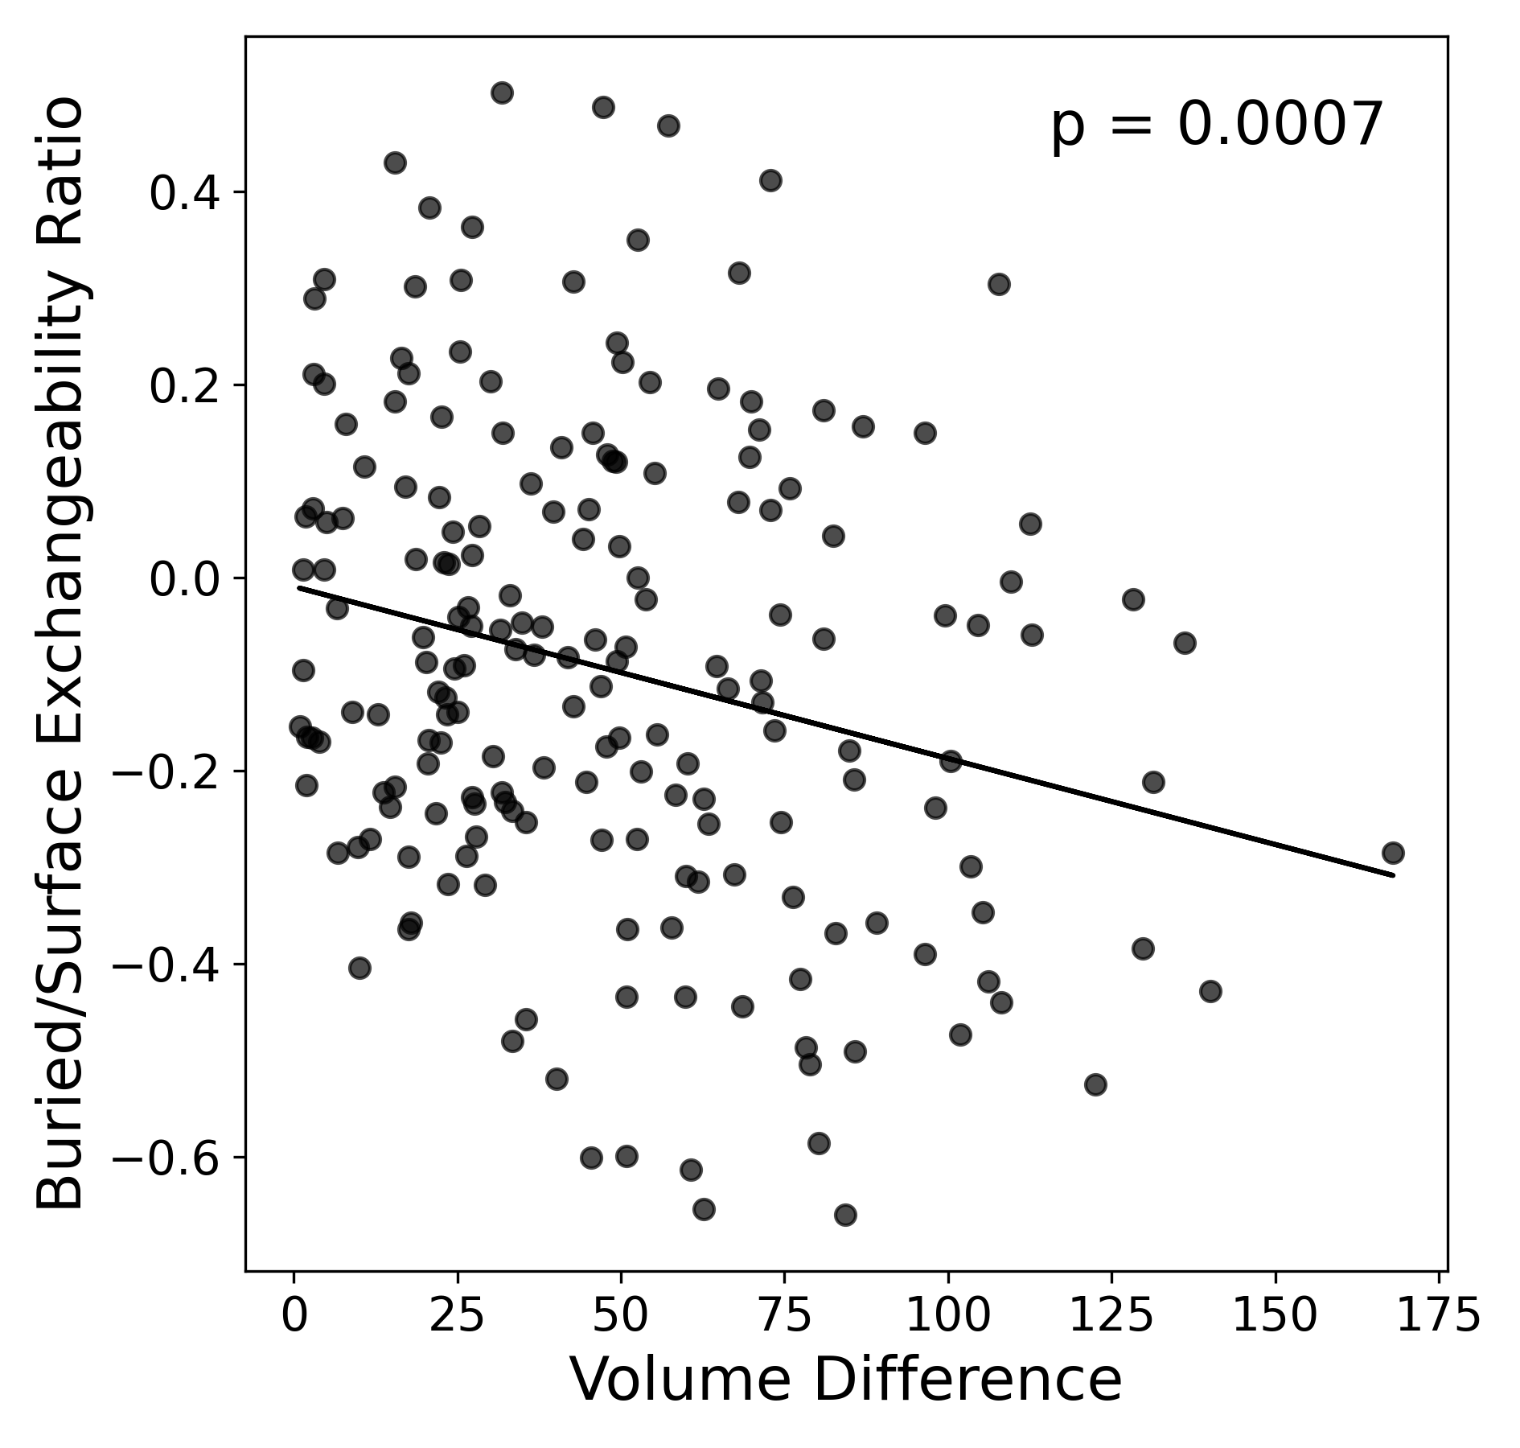
Exchangeabilities match expectation based on biological understanding
A
B
Amino Acids differ in Volume (Size) → Minimal volume change during a substitution is preferred to maintain structural integrity, with a stronger effect on buried residues

Slide 11
Do Structurally Aware Models Improve Fit?

Slide 12
Partitioned Model (Protein Structure Based) performed Better in ~78% of Test MSAs
(3954 vs 1132)

Slide 13
Do Structurally Aware Partition Models Improve Phylogenetic Inference?

Slide 14
What does it mean to “Improve” inference?
Species Tree = Phylogenetic Tree for a set of species inferred using ALL the available genetic data (MSAs)
Gene Tree = Phylogenetic Tree inferred using a single gene (MSA)
Gene Tree closer to Species Tree → Better Gene Tree

Slide 15

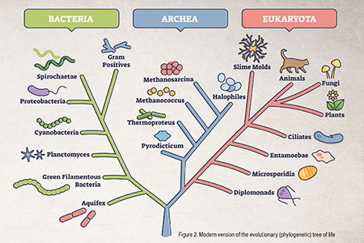
Why Gene Trees?

Slide 16
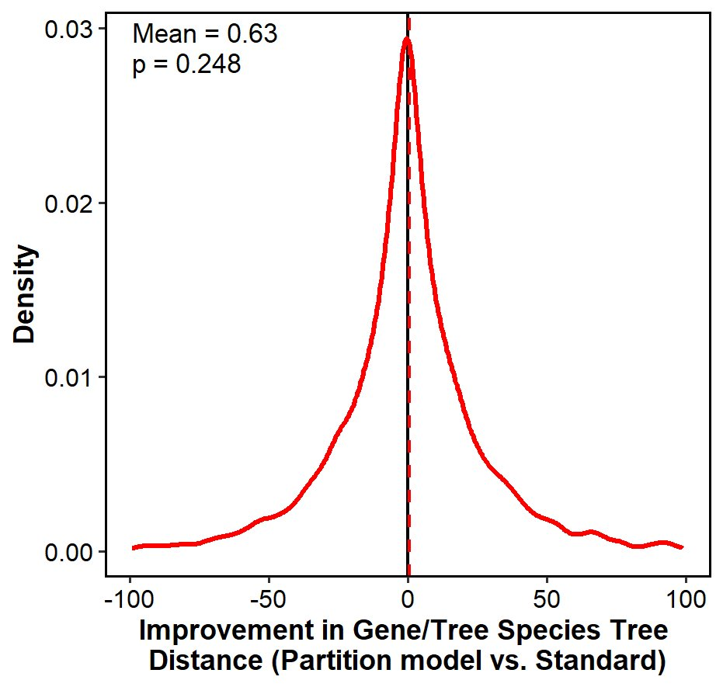
Do Structurally Aware Partition Models Improve Phylogenetic Inference? - No
Percent of genes where partition model performed better/worse

Slide 17
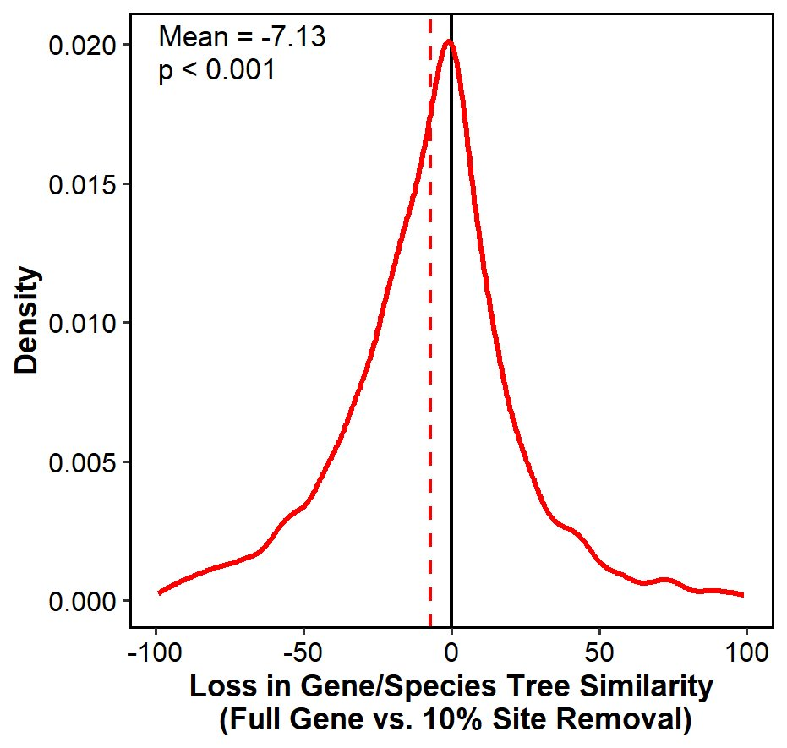
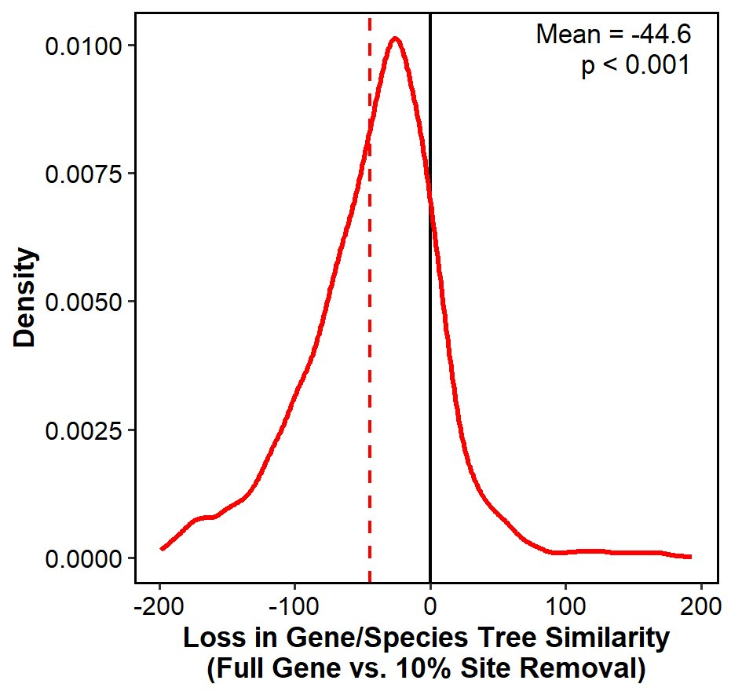
What does worsen gene tree inference? – Randomly removing data
4

Slide 18
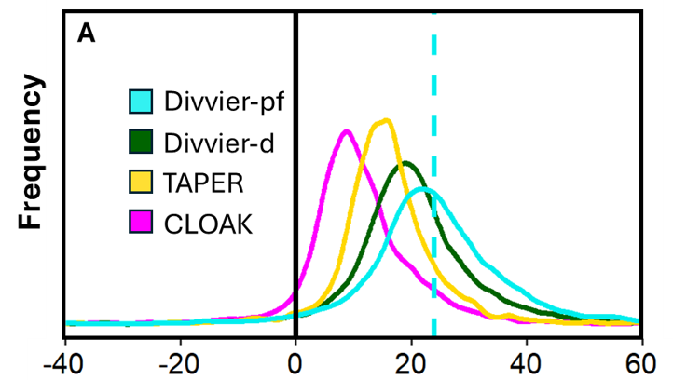

What Improves Gene Tree Inference? – Cleaning our Data

Slide 19

Acknowledgements
Dr. Joanna Masel & the Rest of the Masel Lab
  Andrew Wheeler
  Eris Peto
Drs. Minh Bui, Rob Lanfear, and Gavin Hutley – Australian National University
The University of Arizona Space Grant Team
  Michelle Coe, Dr. Collins, Dr. Shirley
Supported in part through the Arizona NASA Space Grant Consortium, Cooperative Agreement 80NSSC25M7084

Slide 20
Thank You!

